Slide 1
Sichern von (Azure) Informationen mit Cloud App Security
Johannes Nöbauer
Infotech EDV-Systeme GmbH
@noebauer
Notes:
Introduction

Slide 2
Shadow IT
On average, an organization has 28 cloud storage apps routinely used by its employees.
Only 27% of these support multi-factor authentication.
Only 54% of these encrypt data at-rest.
Only 10% of these are compliant with SOC 2, HIPAA and PCI DSS.
Only 49% of these apps claims they are preserving user's right on his own data.
Only 20% of these apps commit on deleting user’s data after account deletion/termination.
On average, an organization has 41 collaboration apps routinely used by its employees.
Only 22% of these support multi-factor authentication.
Only 24% of these encrypt data at-rest.
Only 6% of these are compliant with SOC 2, HIPAA and PCI DSS.
Only 31% of these claim they are preserving user's right on his own data.
Only 18% of these commit on deleting user’s data after account deletion/termination.

Slide 3
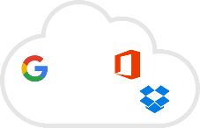


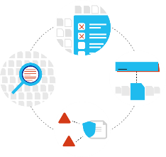
Microsoft Enterprise Mobility + Security
MICROSOFT INTUNE
Make sure your devices are compliant and secure, while protecting data at the application level
MICROSOFT CLOUD APP SECURITY
Gain deep visibility, strong controls and enhanced threat protection for data stored in cloud apps
CONDITIONAL
Classify
ACCESS
AZURE INFORMATION PROTECTION
Classify, label, protect and audit data for persistent security throughout the complete data lifecycle
Location
Access granted to data
Apps
!
Risk
Audit
!
Label
Device
!
Protect
AZURE ACTIVE DIRECTORY
Ensure only authorized users are granted access to personal data using risk-based conditional access
!
MICROSOFT ADVANCED THREAT ANALYTICS
Detect breaches before they cause damage by identifying abnormal behavior, known malicious attacks and security issues

Slide 4

We would like to use a single slide and use this format. Please update the icons. (You can use the icons from slide #13)
How do I gain visibility into cloud apps used in my organization and get a risk assessment?
How can I control and limit access to data in cloud apps?
How can I prevent data loss in cloud apps and stay compliant with regulations?
How do I protect cloud apps and the data in them from security attacks?

Slide 5







Microsoft Cloud App Security
Discover and assess risks
Control access in real time
Protect your information
Detect threats
Identify cloud apps on your network, gain visibility into shadow IT, and get risk assessments and ongoing analytics.
Manage and limit cloud app access based on conditions and session context, including user identity, device, and location.
Get granular control over data and use built-in or custom policies for data sharing and data loss prevention.
Identify high-risk usage and detect unusual behavior using Microsoft threat intelligence and research.
Extend Microsoft security
To your cloud apps
Threat detection: Microsoft Intelligent Security Graph, Office ATP
Information Protection: Office 365 & Azure Information Protection
Identity: Azure AD and Conditional Access
+ more
Discover and assess risks
Discover all cloud usage
in your organization
Information protection
Monitor and control
your data in the cloud
Conditional
access
Control and limit user access based on session context
Threat
detection
Detect usage anomalies and security incidents

Slide 6
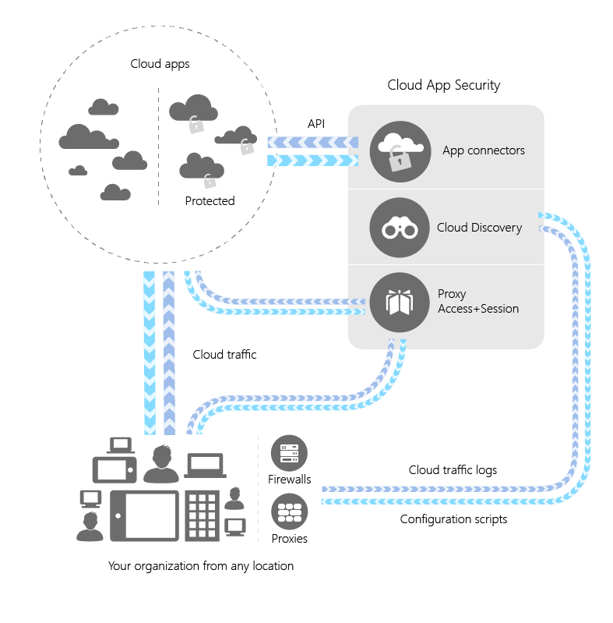
Architecture and how it works
Discovery
Manually or automatically upload traffic logs files from your firewalls and proxies to discover and analyze which cloud apps are in use
Sanction or block apps in your organization using the cloud app catalog
App connectors
Leverage APIs provided by various cloud app providers to extend protection to Cloud App Security
Proxy apps
Azure AD redirects risky sessions to the reverse proxy to apply app restrictions

Slide 7
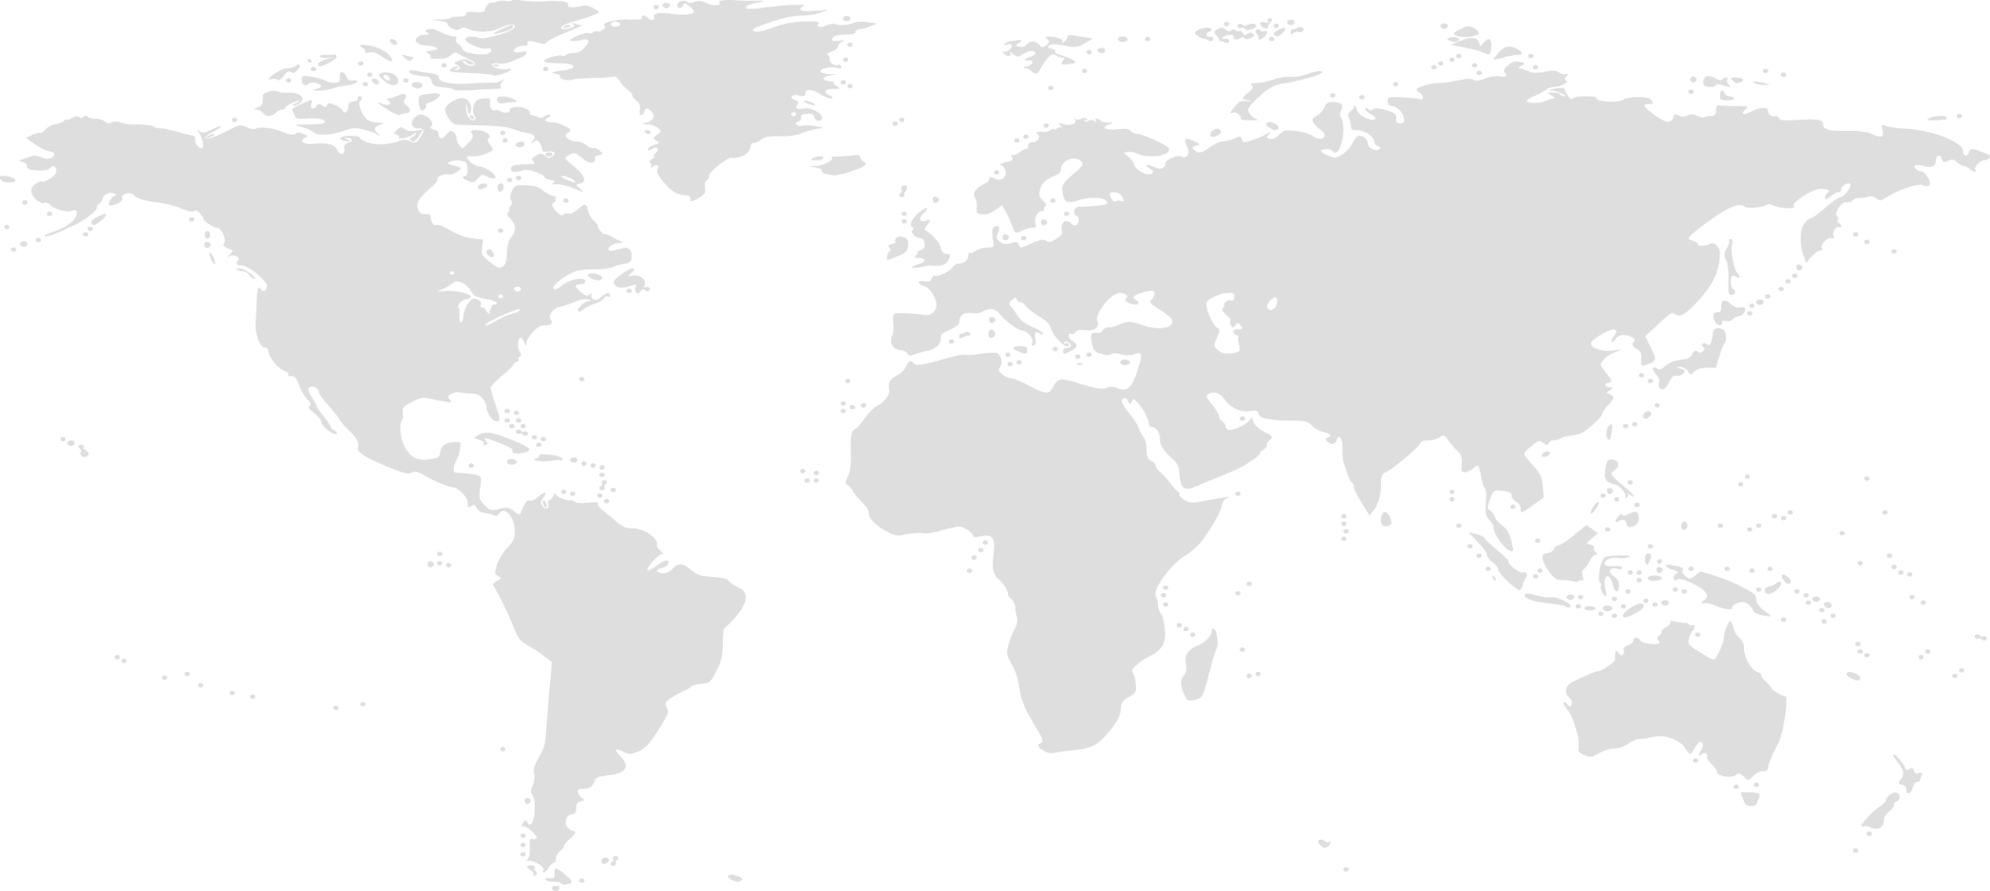

Cloud App Security: Announcements
Cloud App Security: proxy
Control and limit access to cloud apps: Using proxy with Azure Active Directory Conditional Access. Public Preview in October 2017.
Scan, classify sensitive data and apply AIP labels automatically
Automatic labeling and protection will be in public preview in October 2017. Cloud App Security will classify file leveraging Microsoft’s Information Protection solution and capabilities starting Q4 2017.
Support for Azure West Europe region
Cloud App Security is also be available in Azure West Europe region to better serve our customers in Europe and support their compliance requirements
New Cloud App Discovery experience in Azure AD
Cloud App Discovery in Azure AD’s now enhanced to provide deeper visibility into cloud app usage, no agents required, with ongoing analysis and alerts, powered by Cloud App Security. Available to Azure AD customers.

Slide 8
Demo: Create a trial tenant
Log in to your Microsoft work account
Go to www.cloudappsecurity.com or to Enterprise Mobility + Security homepage
Sign up for a free Cloud App Security trial, or Enterprise Mobility + Security all up
Assign licenses to users [at least one]
Login and assign role based access controls
Do-It-Yourself

Slide 9



Cloud discovery
Shadow IT discovery
Risk assessment and migration to business-ready apps
On-going protection and analytics
Discover cloud apps in use across your networks
Investigate users and source IP cloud usage
Create custom views and reports for business units, networks and groups
Optional PII anonymized reports
Risk assessment for 15,000+ cloud apps based on 60 security and compliance risk factors
Un-sanction, sanction and protect apps
Customize labels, notes, weight in risk scoring and override per app risk assessment to support internal workflows
Anomalous usage alerts
New apps and trending apps alerts
Identify and close policy enforcement gaps
Programmatically generate blocking scripts to supported network appliances
Integrates with
Your network appliances, SIEM

Slide 10

Discovery architecture
Azure
On-premise network
Microsoft Cloud App Security
Syslog CEF
Network logs
Log parser
Log collector
App Discovery
SaaS DB
Syslog
FTP
FTP
Discovery dashboard and alerts
Users and groups
Azure AD
Reporting engine
Tenant DB
SIEM
Web proxy
Firewall
Firewall
Cloud apps

Slide 11
Demo: Setup Cloud Discovery reports & alerts
Upload network logs to Cloud App Security
Create custom reports
Create new app alerts
Review discovered apps and take actions
Customize the risk scores
Generate blocking scripts
Live demo

Slide 12
Demo: Set your first activity policy
Navigate to the Policies page
Create a policy and choose “activity policy”
Choose a template, for example, “Mass download by a single user”
Customize parameters, for example, change threshold to 10 downloads
Customize actions in response
Live demo

Slide 13
Microsoft’s approach to
information protection
Comprehensive protection of sensitive data throughout the lifecycle – inside and outside the organization
Detect
Classify
Protect
Monitor
Scan & detect sensitive data based on policy
Classify data and apply labels based on sensitivity
Apply protection actions, including encryption, access restrictions
Reporting, alerts, remediation
Devices
cloud
On premises

Slide 14
Microsoft’s information
protection solutions
Comprehensive protection of sensitive data across devices, cloud services and on-premises environments
Devices
OFFICE 365
CLOUD SERVICES, SaaS APPs & ON-PREMISES
PCs, tablets, mobile
Exchange Online, SharePoint Online & OneDrive for Business
Highly regulated
Azure
3rd-Party SaaS
Datacenters, file shares
Windows Information Protection & BitLocker for Windows 10
Office 365 DLP
Office 365 Advanced Data Governance
Intune MDM & MAM for iOS & Android
Azure Information Protection
Microsoft Cloud App Security

Slide 15




The lifecycle of a sensitive file
Data is detected
Across devices, cloud services, on-prem environments
Data is monitored
Reporting on data sharing, usage, potential abuse; take action & remediate
Data is protected based on policy
Protection may in the form of encryption, permissions, visual markings, retention, deletion, or a DLP action such as blocking sharing
Data is created, imported, & modified across various locations
Data travels across various locations, shared
Protection is persistent, travels with the data
Sensitive data is classified & labeled
Based on sensitivity; used for either protection policies or retention policies
Retain, expire, delete data
Via data governance policies

Slide 16



Information protection for cloud apps
Gain visibility into data and sharing
Classify, label and protect
Monitor & investigate
Visibility to sharing level and classification labels
Quantify over-sharing exposure and compliance risks
Detect and manage 3rd apps access
Govern data in the cloud with granular DLP policies
Leverage Microsoft’s Information Protection capabilities for classification
Automatically protect and encrypt your data using Azure Information Protection
Identify policy violations
Investigate incidents and related activities
Quarantine and permissions removal
Integrates with
Azure Information Protection, Office 365, External DLP solutions

Slide 17
Demo: Azure Information Protection
Navigate to the Azure Portal on the AIP page
Create a policy
Show Client
Protect a File
Upload to BOX
Share the File to everyone
Live demo

Slide 18



Files and Data Control Architecture
Azure
Microsoft Cloud App Security
Protected cloud apps
Files API
Violation remediation (e.g. quarantine) & notification
File directory
Event processing
Files for re-scan as part of the ongoing scan process
File notifications for new and updated files
Activity API
Scan queue
3rd party DLP engine
Proxy
traffic
Selected file for scan
Files
External collaborators
Users
Content scan engine
DLP engine
Download file for scan
Extracted text
Remediation API
SIEM connector (preview)

Slide 19


Conditional Access Capabilities
Azure AD: Conditional access for any app with set of conditions
Intune: adds mobile device compliance
Cloud App Security Access Proxy (private preview)
Extends AAD Conditional Access to legacy SSO
Office 365 Conditional Access:
Application level implementation to enforce device, data access and location restrictions
Cloud App Security Session Proxy:
Inline implementation to enforce device, data access and location restrictions
EMS + Office 365

Slide 20


Conditional Access: Proxy
Context-aware session policies
Investigate & enforce app and data restrictions
Unique integration with Azure AD
Control access to cloud apps based on user, location, device and app
Identify managed devices via VPN (location based), Domain joined devices, Intune compliant devices or client certificates
Supports any SAML-based app, any OS
Enforce browser-based “view only” mode for low-trust sessions
Limit access to sensitive data
Classify, label and protect on download
Visibility into unmanaged device activity
Integral component of Azure AD Conditional Access
Simple deployment directly from your Azure AD portal
Leverages existing device management mechanisms, no additional deployment required
Integrates with
Public Preview in October
Join now, email us at mcaspreview@microsoft.com
Azure Active Directory

Slide 21
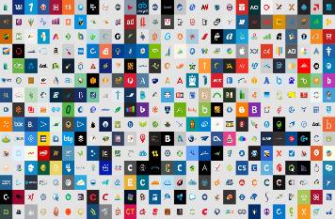






Monitor and control access to cloud apps
CLOUD APP SECURITY
Allow access
Require MFA
Proxy
Limit access
Cloud apps
Policy
Deny access
******
Force password reset

Slide 22

Conditional Access – Block on download
Cloud App Security Proxy
USER
DEVICE
APP
SESSION RISK
Role: Marketing Mgr
Group: Marketing
Client: Mobile
Config: Open
Location: UNKNOWN
Last Sign-in: 8 hrs ago
Platform: Windows
Health: Fully patched
Config: Managed
Last seen: London, UK
Block on download
Unfamiliar IP address.

Slide 23
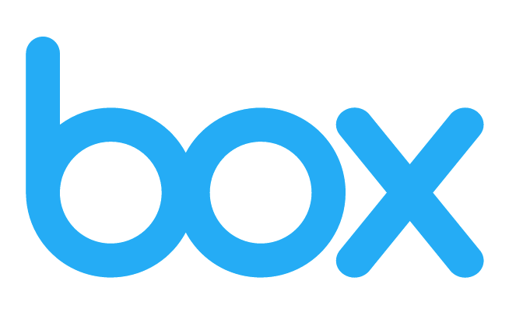
Conditional Access – Allow on Download
Cloud App Security Proxy
USER
DEVICE
APP
SESSION RISK
Role: Marketing Mgr
Group: Marketing Users
Client: Mobile
Config: Corp Proxy
Location: London, UK
Last Sign-in: 5 hrs ago
Platform: Windows
Health: Fully patched
Config: Managed
Last seen: London, UK
Classification Engine

Slide 24
Conditional Access – Protect on Download
Cloud App Security Proxy
USER
DEVICE
APP
SESSION RISK
Role: Vendor
Group: Contingent Staff
Client: Mobile
Config: Open
Location: Red Bank, NJ
Last Sign-in: 3 hrs ago
Platform: Windows
Health: Fully patched
Config: Unmanaged
Last seen: Red Bank, NJ
Protect on download
User is a not a full-time employee.
Device is unmanaged

Slide 25
Demo: Setup conditional access proxy
Navigate to Azure AD > Enterprise apps > Conditional Access
Apply the required assignments: choose your app, user scope and other conditions
Under Access Controls, check “Use proxy enforced restrictions”
Configure the required session policies in Cloud App Security
Live demo

Slide 26
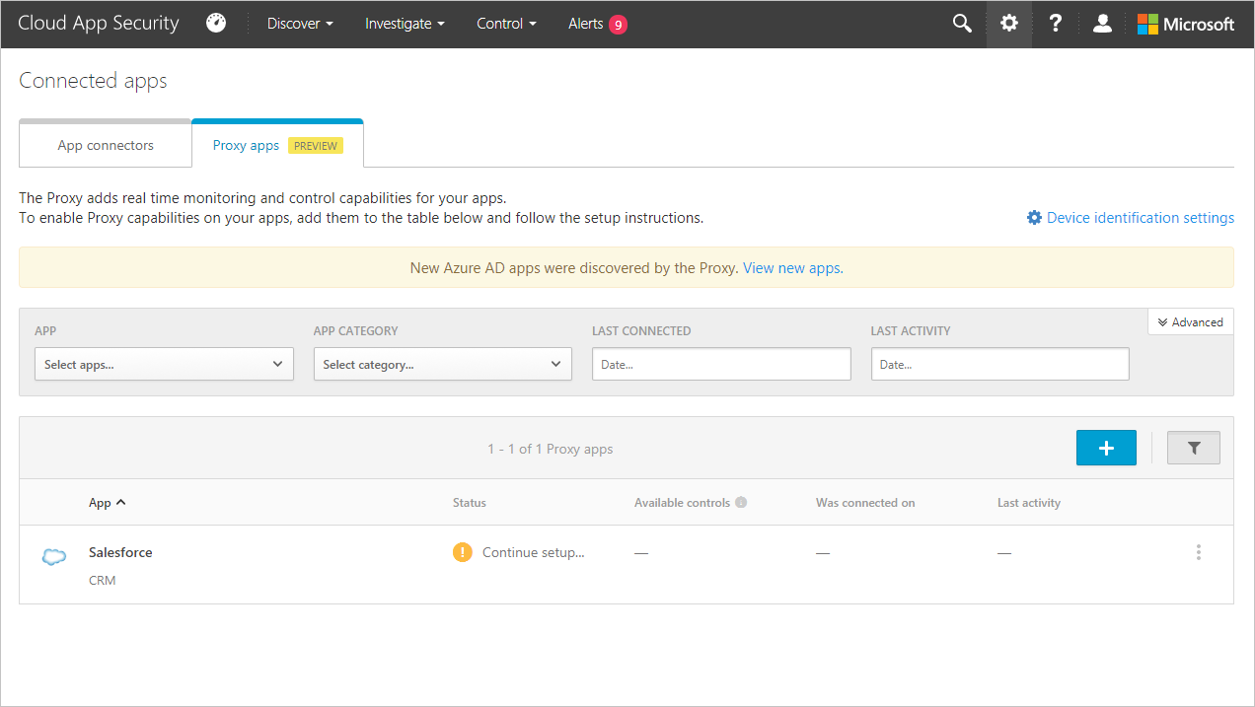
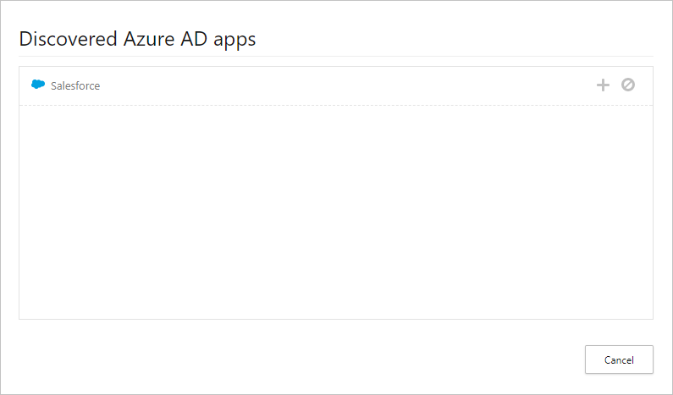
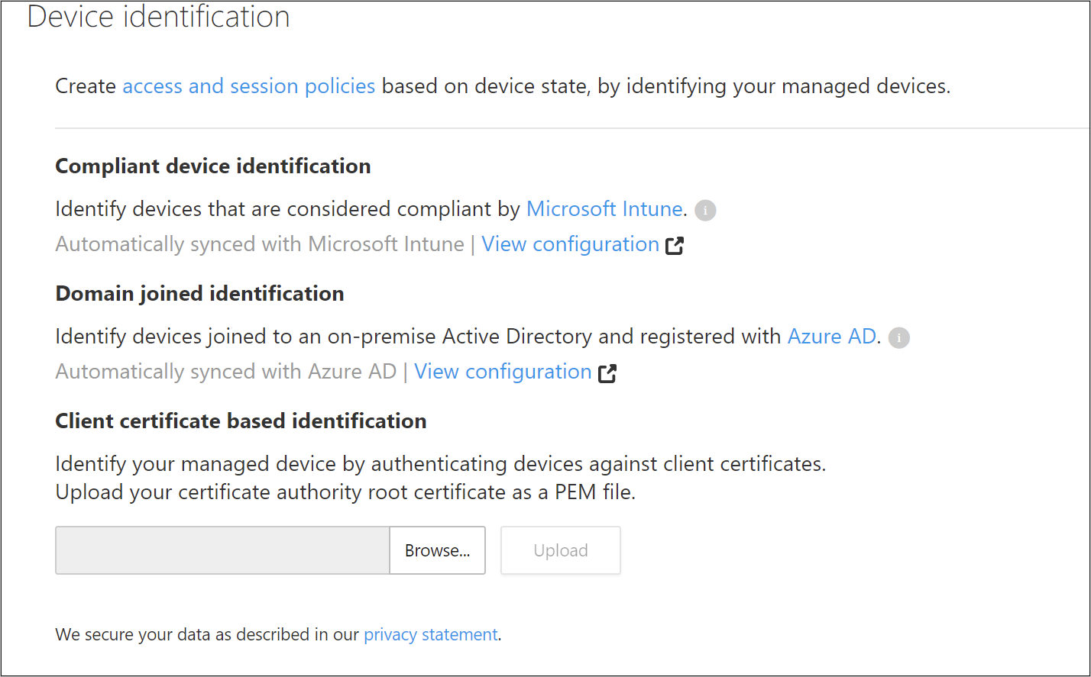

Slide 27

Threat detection & investigation
Behavioral analytics & ransomware detection
Advanced investigation & remediation
Threat Intelligence
Identify anomalies in your cloud environment via advanced behavioral analytics
Built-in detections for leading threat scenarios: Ransomware, admin take-over, shared accounts
Pivot on users, IP addresses, resources, activities and locations
Customize detections based on your findings
Automate remediation with Azure AD
Leverages Microsoft Intelligent Security Graph: Unique insights, informed by trillions of signals across Microsoft’s customer base
Native integration with Office Threat Intelligence
Integrates with
Microsoft Intelligent Security Graph, 3rd party SIEM solutions

Slide 28
Activity & Anomaly detection Architecture
Microsoft Cloud App Security
Azure
Protected cloud apps
Proxy
traffic
Event enrichment
Geo-location database
Users/Groups
Microsoft Threat Intelligence Center
Alerts engine
Activity API
Alert investigation & notification
Based on big data and machine learning
- Anomaly detection
- Activity policy evaluation
e.g. risky IP addresses
Users
Support
Admins
SIEM connector (preview)

Slide 29

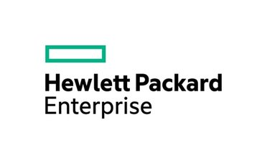



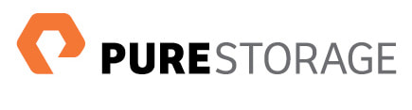
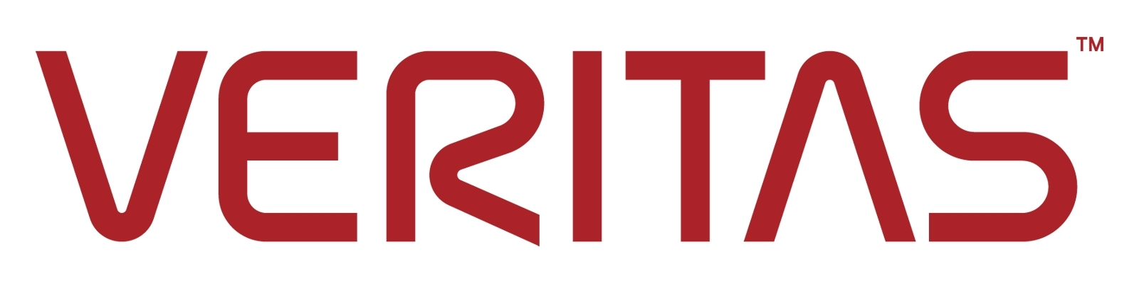



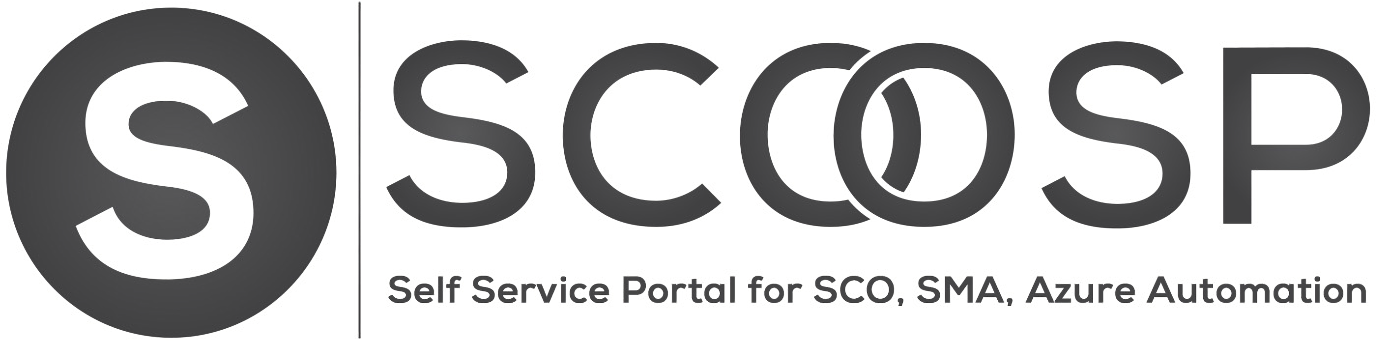




Thanks to our Sponsors!

